Slide 1
Caregiver Conversations
Who Does What?
RAE
Regional Accountable Entity
CMA
Case Management Agency
HCPF
Healthcare Policy and Financing
CCB
Community Centered Board
DHS
Department of Human Services
SSA
Social Security Administration
MCH
Maternal Child Health
www.familyvoicesco.org (303) 877-1747 info@familyvoicesco.org

Slide 2
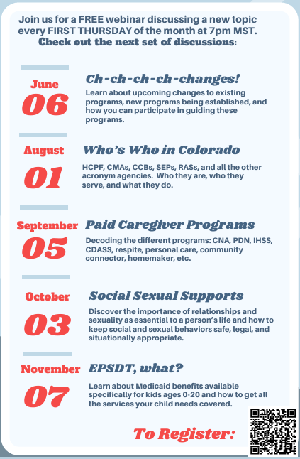
Caregiver Conversations
Webinars on the first Thursday of every month.
7:00 PM-8:30 PM
We know your time is precious we and are committed to providing information in a specific timeline.
Our timeline:
7:00-7:05 Intro and Overview
7:05-8:20 Information
8:20-8:30 Questions
NOTE: Please do not share private health information, as we are recording this webinar. If you have questions that are of a more private nature, one of our staff will connect with you, at another time.

Slide 3
Presenter Asks
Define all ALL acronyms
Family friendly explanations
Overview - stay out of the weeds
https://www.dpcolo.org/wp-content/uploads/2023/11/Acronym-Guide.pdf

Slide 4
Healthcare Policy and Financing (HCPF)

Slide 8
Social Security Administration (SSA)
Social Security provides financial protection for our nation’s people, supporting Americans throughout all of life’s journeys.
Provides Social Security numbers
Administers retirement, disability, survivor, and family benefits
Completes disability determinations for some programs

Slide 9
Social Security Disability Programs
Social Security Disability Insurance (SSDI)
Must be Blind or Disabled
Must have work history (paid into social security retirement during working years)
Monthly financial assistance - amount dependent on amount paid in while working
Benefits also available for dependents
Medicare eligible after 24 months
Supplemental Security Income (SSI)
Must be Blind or Disabled
Must have very limited income and resources
Monthly financial assistance - amount based on income and assets
Automatic Medicaid eligibility

Slide 10
Social Security Disability Programs (cont.)
Disabled Adult Child (DAC)
18 or older
Have a disability that started before age 22
Has a parent receiving social security retirement, SSDI benefits, or who is deceased but worked enough to earn social security retirement benefits
Percentage of the parent’s eligible amount (usually 50%)
Contact to start process: 1-800-772-1213

Slide 11
Questions?
Main Contact:
(303) 877-1747
info@familyvoicesco.org
Megan Bowser – Executive Director
megan@familyvoicesco.org
Christy Blakely - Senior Advisor
christy@familyvoicesco.org
Brenda Delgado - Bilingual Family Navigator
brenda@familyvoicesco.org
Jamie Stefanski - Adult and Transition Family Navigator
jamie@familyvoicesco.org
Corinne Depersis - Child Family Navigator
corinne@familyvoicesco.org
Kayleigh Sheble - Southern Colorado Family Navigator
kayleigh@familyvoicesco.org
Aubree McKinney - Western Colorado Family Navigator
aubree@familyvoicesco.org

