Slide 1
Medicaid 101
www.familyvoicesco.org (303) 877-1747 info@familyvoicesco.org

Slide 2
What is CHP+
Child Health Plan Plus (CHP+) is part of Colorado’s public health insurance programs for uninsured pregnant women and children from birth to age 18 whose families make too much to qualify for Medicaid, but cannot afford private insurance for their children. CHP+ has copays and does not provide as much coverage as Medicaid, but is a great option for those with typical medical needs.
Apply at your county Dept. of Human Services or at www.colorado.gov/PEAK
.

Slide 3
What is Medicaid? (Health First Colorado)
Medicaid is a federal and state program that provides medical assistance to individuals based on eligibility requirements for technical and financial criteria as defined in the policy.
For every dollar Medicaid pays for healthcare, $0.50 is paid by federal funds and $0.50 is pay by state funds.
No Copays for ages 0-21
No Deductibles
All medically necessary services are covered for ages 0-21 (EPSDT)
Home Healthcare - CNA, PDN, Personal Care
No hard limits on therapy visits a year
Medical supplies like diapers, wipes, formula, etc
Durable medical equipment (DME) like wheelchairs, standers, etc

Slide 4
CHP+ vs Medicaid
 | CHP+ | Medicaid
Cost: | Low copays for many services | No copays or deductibles ages 0-21 Low copays for adults 22 and older
Eligibility: | -Children and pregnant women (no disability requirements) -Income less than 260% FPL -No access to private health insurance | Varies by program Low-income based programs and disability based programs
Coverage: | Doctor visits, emergency care, preventive care such as screenings and immunizations, dental care, and other procedures and treatments | All medically necessary services, equipment, prescriptions, home healthcare, dental care, vision, DME, supplies, etc. are fully covered
Which providers can I see: | Managed Care Organization designated by your county | Choice of seeing any provider who accepts Medicaid or enrolling in a Managed Care Organization

Slide 5
Medicaid - Health First Colorado
Benefits Pyramid
HCBS Waivers
Waivers, participant-directed services, transition services
Long-Term Care
Nursing facility services, home health, case management
State Plan (Regular Medicaid)
Inpatient and outpatient hospital services, physician services, laboratory and x-ray services, prescription drugs, dental services, and more
www.familyvoicesco.org (303) 877-1747 info@familyvoicesco.org
‹#›

Slide 6
EPSDT
Early and Periodic Screening, Diagnostic, and Treatment
It is a federal mandate. It doesn’t allow hard limits on children (0-21) services.
Provides comprehensive services and furnishes all Medicaid coverable, appropriate, and medically necessary services needed to correct and ameliorate health conditions.
Ages 0-21
Screening
Vision
Dental
Hearing
Diagnostic
Treatment
Other - Medically Necessary

Slide 7
Medicaid Administration
Health First Colorado (Medicaid) is under the Department of Healthcare Policy and Financing (HCPF) and is overseen by Centers for Medicaid and Medicare Services(CMS)
https://hcpf.colorado.gov
Medicaid eligibility in Colorado is determined by each county Department of Human Services, the Social Security Administration (for SSI recipients), and Single Entry Points or Community Centered Boards (for waiver recipients)
The Department of Human Services also determines eligibility for other public assistance programs, such as: SNAP, Energy assistance, CCAP, or Temporary Aid to Needy Families. (TANF)

Slide 8
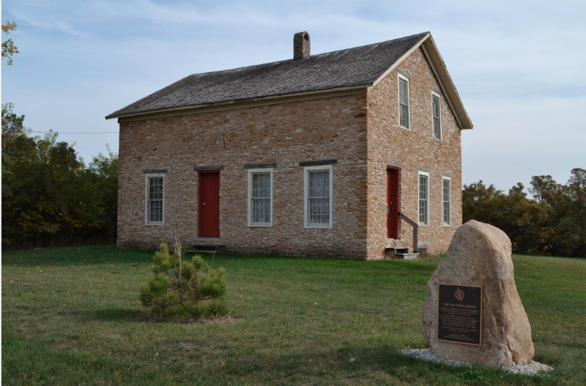
The Medicaid House
There are different ways to get into the Medicaid house
-doors and windows-
Income Based (SSI or MAGI Medicaid)
Family income and assets requirements
No disability requirements
Medicaid Buy-in
Family Income requirements
Disability as determined by Social Security Administration (SSA)
Medicaid HCBS Waivers
*Child’s* income and asset requirements
Disability per SSA
Functional Criteria (100.2)
Waiver Specific targeting criteria
Adoption Agreement
www.familyvoicesco.org (303) 877-1747 info@familyvoicesco.org

Slide 9
Income Based Programs
MAGI Medicaid
Medicaid for low income children, adults, and pregnant women
No disability requirements
Apply at your county’s Department of Human Services or online at www.colodo.gov/peak

Slide 10
Income Based Programs cont.
Supplemental Security Income (SSI)
Federal income supplement program for children and adults with disabilities. Provides automatic eligibility for Medicaid.
To be eligible you need to meet the following criteria
Little or no income (less than $1,913 per month)
Little or no resources (less than $2000 for an individual or $3000 for a couple)
A disability, blindness, or are age 65 or older.
Apply at your local social security office or online at www.ssa.gov

Slide 11
Medicaid Buy-In Program
Who is eligible?
Are a US citizen
Are under age 19 (there is a similar program available for adults)
Have a qualifying disability according to Social Security Administration
Family income is below 450% of Federal Poverty Level (FPL)
Monthly premium based on family income
Provides access to State Plan and LTSS (if eligible) only
www.familyvoicesco.org (303) 877-1747 info@familyvoicesco.org

Slide 12
Home and Community Based Services (HCBS)
Waivers for Children
Provide access to
State Plan Medicaid
Long-term Care
HCBS specific services
“Waive” family income and assets and instead look only at the child’s income and assets

Slide 13
HCBS Waiver - Eligibility
Citizenship and Residency
Citizen of the United States or a qualified non-citizen
Resident of Colorado
Disability
Social Security Administration definition of disability
www.familyvoicesco.org (303) 877-1747 info@familyvoicesco.org

Slide 14
HCBS Waiver - Eligibility
Functional Criteria for Long Term Supports and Services (LTSS)
Long Term Care 100.2 Assessment:
Bathing
Dressing
Toileting
Eating
Mobility
Transferring
Supervision Cognitive/Memory
Supervision Behavioral
Abilities are scored from 0-3. Child required to score a score of “2” in at least two ADL areas or a score of “2” in at least one of the Supervision areas.
www.familyvoicesco.org (303) 877-1747 info@familyvoicesco.org

Slide 15
HCBS Waiver - Eligibility
Financial Criteria
The child/adult's income must be less than $2,742 a month in 2023 (300%, or three times, the Supplemental Security Income allowance)
The child/adult’s countable resources (assets) less than $2,000
Targeting Criteria
Different for each Waiver program based on purpose for each Waiver
www.familyvoicesco.org (303) 877-1747 info@familyvoicesco.org

Slide 16
HCBS Waivers
6 Adult Waivers:
Brain Injury Waiver (BI)
Community Mental Health Supports Waiver (CMHS)
Complementary and Integrative Health Waiver (CIH)
Developmental Disabilities Waiver (DD)
Elderly, Blind and Disabled Waiver (EBD)
Supported Living Services Waiver (SLS)
4 Children’s Waivers:
Children with Life Limiting Illness Waiver (CLLI)
Children's Extensive Support Waiver (CES)
Children's Habilitation Residential Program Waiver (CHRP)
Children's Home and Community Based Services Waiver (CHCBS)
More details here: https://hcpf.colorado.gov/hcbs-waivers
www.familyvoicesco.org (303) 877-1747 info@familyvoicesco.org

Slide 17
How do I apply?
 | MAGI | SSI | Buy-in | HCBS Waivers
Medicaid Application www.colorado.gov/peak or County Department of Human Services or With assistance from Case Manager | x | x | x | x
Disability Determination County Department of Human Services - Application goes to ARG/Arbor for review or Social Security Administration |  | x | x | x
Level of Care and Waiver Application Community Centered Board or Single Entry Point soon to be… Case Management Agency |  |  |  | x

Slide 18
How do I renew?
 | Programs | Frequency
Medicaid Application www.colorado.gov/peak or County Department of Human Services or With assistance from Case Manager | ALL | Annually
Disability Determination County Department of Human Services - Application goes to ARG/Arbor for review or Social Security Administration | SSI, Buy-in, Waivers | Every 5-7 years
Level of Care and Waiver Application Community Centered Board or Single Entry Point soon to be… Case Management Agency | Waivers | Annually

Slide 19
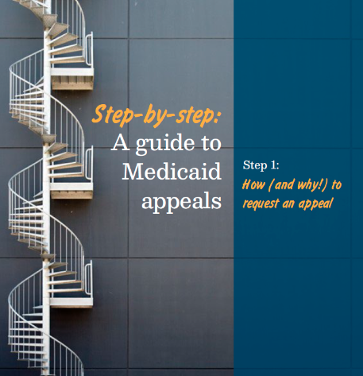
What To Do if You are Denied
If you agree with the decision, you do not need to take any further action
If you think the decision is wrong, you can appeal and ask for a hearing. You may have an appeal hearing with an Administrative Law Judge. You may represent yourself, or have a lawyer, a relative, a friend, or other spokesperson assist you as your authorized representative
Appeal information is always on the letter denying services
A request for a fair hearing with Administrative Law Judge (ALJ) can be made
There is a time limit when an appeal can be made, depending on program rules
Appeal is the ONLY way to get Continued Benefits while you wait
CCLP Medicaid Appeals Guide

Slide 20
How to APPEAL
You must ask for a hearing in writing. This is called a LETTER OF APPEAL.
Your letter of appeal must include:
Your name, address, phone number and Medicaid number;
Why you want a hearing
You do not need to include a lot of details. For example, you could write: “Health First (Medicaid) denied my application. I disagree with this decision.”
A copy of the front page of the notice of action you are appealing (if you have one)
A list of any accommodations you need (language interpreter, telephone hearing, etc.)
Whether you want your benefits to continue while you go through the appeal process.
Your Signature

Slide 21
How to APPEAL cont.
Mail or fax your letter of appeal to:
Office of Administrative Courts
1525 Sherman Street, 4th Floor
Denver, CO 80203
Fax: 303-866-5909
Timeline:
Your letter of appeal must be received by the Office of Administrative Courts no later than sixty (60) calendar days from the date on this notice of action. The date of the notice of action is located on the front of this notice.
If you want continued benefits during the appeal process, your appeal must be received before your benefits end date.
The Office of Administrative Courts will contact you by mail with the date, time, and place for your hearing with the Administrative Law Judge.

Slide 22
Upcoming Changes
Case Management Redesign
One agency per region to manage all HCBS waivers
“Conflict Free” - case management and direct services can’t be provided by the same agency
Started now and will be fully implemented 7/2024
https://hcpf.colorado.gov/case-management-redesign
www.familyvoicesco.org (303) 877-1747 info@familyvoicesco.org

Slide 23
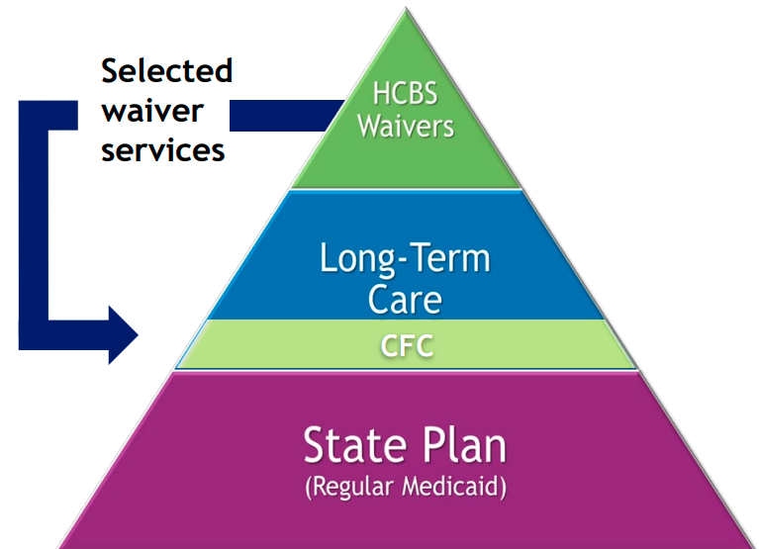
Upcoming Changes cont.
Community First Choice (CFC)
Transition some services from HCBS waivers to be available to any Medicaid member who meets the level of care needs regardless of how they access Medicaid
Services transitioning are still being finalized, the biggest impact will be expansion of IHSS and CDASS
Will start 7/2025
https://hcpf.colorado.gov/community-first-choice-option
www.familyvoicesco.org (303) 877-1747 info@familyvoicesco.org

Slide 24
Question & Answers

Slide 25
Thank You
for attending!!
Contact:
Main number (303) 877-1747
Christy Blakely - Executive Director
christy@familyvoicesco.org
Megan Bowser – Deputy Director, Family Navigator
megan@familyvoicesco.org
Gaby Diaz - Bilingual Family Navigator
gaby@familyvoicesco.org
Next Caregiver Conversations
Children’s HCBS Waivers, Oct 5, 2023, 7-8:30PM

