Slide 1

Transition to Adult Services
www.familyvoicesco.org (303) 877-1747 info@familyvoicesco.org

Slide 2

Family Voices Overview
Family Led Nonprofit
Provide:
Systems Navigation
Education and Training
Advocacy and Policy
F2F Health Information Center
Affiliate of Family Voices national organization
Christy S. Blakely
https://www.familyvoicesco.org/
(855) 877-1747
info@familyvoicesco.org

Slide 3
Changes at Age 18
“Transition”
At age 18, an adolescent becomes emancipated, from parents, regardless of ability
At age 18 their rights as an adult begin, which means:
  Parents no longer have access to records, communication with any providers, without the consent of the youth school, medical, or financial
  Family Income is no longer considered for most services
  At 18, if there is a bank account in adolescences' name, you must be listed as a co-signer, or you will not have access
  Even if your adolescent is nonverbal or has limited decision making, you will be unable to access or communicate without their consent
  If, male, they must sign up for military!
www.familyvoicesco.org (303) 877-1747 info@familyvoicesco.org

Slide 4
Families need to discuss:
What the transitioning Adult likes and is good at doing
Where the individual is going to live and goals, at 18, 21, 26, 30 35…
This may be a time for a PATH Plan
The PATH Plan is...
A process which provides an opportunity for the individual and families to plan for and reach new PossAbilities with Person-Centered PathAbilities.
It uses a person-centered planning tool called the PATH (Planning Alternative Tomorrows with Hope) Plan.
Ways to increase the transitioning youth’s independence!

Slide 5
Let’s Take a Step Back
There are Different Types of Transition!
Transition can start as early as age 10!
Medical & IDD
School/Employment
Legal
Financial

Slide 6
Medical & IDD - Transition
Medical Transition includes:
      1. Decision making about insurance
      Do I keep my child on my private insurance after age 18? Legally, you can, until 26!
      Depending on the insurance carrier, you can petition every year for a disabled adult to stay on your private insurance-
      WHY keep them on private insurance? Access to doctors, access to care, better payments for providers, better overall coverage
      2. Decision making about Transitioning to Adult Health Care
      Ask each provider their age/stage when they transition to adult care
      Create a plan for transitioning and get the records to share
      Create a care notebook to communicate to new providers both medical history and goals
      3. Decision making about how to access Home Health Care (if appropriate)
      Discuss the options with case manager or someone who understands consumer Directed Attendant Support Services, versus agency, based home health care.
      https://hcpf.colorado.gov/consumer-directed-attendant-support-services
      4. Early, Periodic, Screening Diagnostics and Treatment (EPSDT) under Medicaid is from 0- 21st birthday. https://hcpf.colorado.gov/early-and-periodic-screening-diagnostic-and-treatment-epsdt
www.familyvoicesco.org (303) 877-1747 info@familyvoicesco.org
6

Slide 7
Medical & IDD - Transition
IDD Transition includes:
      1. Decision making about Intellectual Developmental Disability(IDD) services
      Which Home and Community Based Service (HCBS) Waiver is best for my young adult? (webinar on Adult HCBS Waivers on June 1, 2023)
      https://hcpf.colorado.gov/sites/hcpf/files/HCBS%20Adult%20Waiver%20and%20PACE%20Comparison%20Chart-April-2023.pdf
      At 18 in the IDD waivers there is an evaluation called the Supports Intensity Scale (SIS)
      This eval equals level of care and that equated to the funding your young adult will receive
      Once on an IDD waiver (DD or SLS) a Service Plan (soon to be called a Person Centered Support Plan) will be written, related to goals and needs, this is written annually, along with the ULTC 100.2 assessment
      The SIS is done once and re-evaluated if there are significant changes.
      In order to qualify for Developmental Disability services the young adult must have an IQ under 70 OR an Adaptive Behavior Score that is low.
www.familyvoicesco.org (303) 877-1747 info@familyvoicesco.org
7

Slide 8

Electronic Medical Records
Access to your child's electronic health record (My Chart) varies by age:
Under 14: Parents have full access to the child's MyChart account.
Ages 14-18: In order to provide confidentiality for our patients, parents have limited access. Parents can continue to message the care team and see test results. Teen patients can request their own MyChart account with full access to their health record.
18 or older: Parents cannot create a MyChart account. The patient may have their own MyChart account.
Special needs: If a child has diminished capacity and is unable to make healthcare decisions, an exception can be made that allows parents to retain full access to their child's MyChart account. Please discuss this with your child's healthcare team.
Check with your young adult’s providers!
This Photo by Unknown Author is licensed under CC BY-SA

Slide 9
Adult Paid Family Caregiver Options
CNA or PDN
Is available under the EBD or SLS
Must qualify for Long-term Care
Must qualify for skilled care, hours are determined by PAT tool until 21 or in home assessment by a nurse
Family member must obtain their CNA or nursing license
Employed by a home health agency with same requirements as if a non-family member provided services
CDASS
Is available under EBD or SLS
Must be on the EBD or SLS Waiver
Must qualify for skilled care - health maintenance activities (HMA)
CHCBS case manager completes assessment to determine hours
Nurse Practice Act is waived so no licensure is required
Employed by a home health agency
May be provided by family members or outside providers
www.familyvoicesco.org (303) 877-1747

Slide 10
Adult Paid Family Caregiver Options
DD waiver pays a daily rate, based on Supports Intensity Score (SIS) score
Is available under the EBD or SLS
There is NO home health benefit under the DD Waiver
PDN changes for adults
No services shall be authorized or reimbursed if hours of service, regardless of funding source, total more than 24 hours per day for members age 20 or younger and no more than 23 hours per day for members age 21 or older.
www.familyvoicesco.org (303) 877-1747

Slide 11
Financial- Transition
Financial Transition includes:
      1. Decision making about Supplemental Security Income (SSI)
      Does my young adult qualify for SSI?
      Will my young adult be working?
      Does my young adult have a disability determination?
      Is my child moving out of my home? (If not, they will need to pay rent is receiving SSI)
      Which Home and Community Based Service (HCBS) Waiver is best for my child? (June 1, 2023)
      2. Decision making about creating Special Needs Trust
      Discuss with someone knowledgeable about Special Needs Trusts and why they are important. (July 6, 2023)
      Parents at this age worry for when they are not around, plan!
      Ensuring the adult child has a bank account with a parent/caregiver/guardian’s name on it
          SSI limits individuals to no more than $2000 available, options include ABLE accounts.
www.familyvoicesco.org (303) 877-1747 info@familyvoicesco.org
11

Slide 12


What are ABLE accounts?
Achieving a Better Life Experience Act of 2014 (ABLE)
Not part of the $2,000 cap for Supplemental Security Income (SSI) and Medicaid.
✓ Grows tax deferred and tax-free access.
✓ One ABLE account per person.
w w w . c o l o r a d o a b l e . o r g

Slide 13
Onset of disability occurs before age 26, then
Eligible individuals
Eligible for Supplement Security Income (SSI)
Self-certification
w w w . c o l o r a d o a b l e . o r g

Slide 14

Death of ABLE Account Designated Beneficiary
Medicaid agencies cannot seek reimbursement
$17,000 Annual contribution
Many qualified disability Expenses (Housing, Transportation, Health and Wellness, Education and basic living expenses).
To enroll go to www.coloradoABLE.org
w w w . c o l o r a d o a b l e . o r g

Slide 15
Who is Eligible for SSI?
Adults Who:
Are age 65 and older, or blind, or have a disability.
Have limited income (wages, pensions, etc.).
Have limited resources (the things you own).
Are U.S. citizens, nationals of the U.S., and some noncitizens.
Reside in one of the 50 states, the District of Columbia, or the Northern Mariana Islands. It does not include Puerto Rico, Guam, or the United States Virgin Islands. Exception: The children of military parent(s) assigned to permanent duty outside the U.S. and certain students temporarily abroad may receive SSI payments outside the U.S.
https://www.ssa.gov/ssi/
Children Who:
Are under age 18 and have physical or mental condition(s) that very seriously limits their daily activities for a period of 12 months or more or may be expected to result in death, and
Live in a household with limited income (benefits based on need) or resources.
https://www.ssa.gov/benefits/disability/apply-child.html

Slide 16
School & Employment- Transition
School & Employment Transition includes:
      1. Decision making about school services
      Do I keep my child in the school Transition program after age 18?
      Typically, they graduate with their class at 18, then have 3 years(until 21 in a transition program)
      Transition Programs can be anything from learning life skills to job training to higher education, it is an individualized program
      Is continued or higher education a possibility?
      If higher education, there must be a work-related goal.
      Higher education is becoming more available, for individuals with IDD!
      2. Decision making about Employment
      Discuss as a family what your young adult likes or can do, investigate or shadow, if possible
      Discuss as a family obtainable goals
      Ask about Division of Vocational Rehabilitation(DVR)
      Ask about the SWAP Program https://dvr.colorado.gov/youth-transition-services/youth
www.familyvoicesco.org (303) 877-1747 info@familyvoicesco.org
16

Slide 17
Legal-Transition
Legal Transition includes:
      1. Decision making about Power of Attorney and/or Guardianship
      Understand the differences in Medical Power of Attorney, Power of Attorney and Guardianship (webinar July 6, 2023)
      2. Guardianship Alliance, Guardianship classes
      https://www.abilityconnectioncolorado.org/guardianshipallianceofcolorado/guardian-training-classes
      Upcoming classes: The cost of the Guardianship Training Class is $150.00
November 9, 2023
www.familyvoicesco.org (303) 877-1747 info@familyvoicesco.org
17

Slide 18
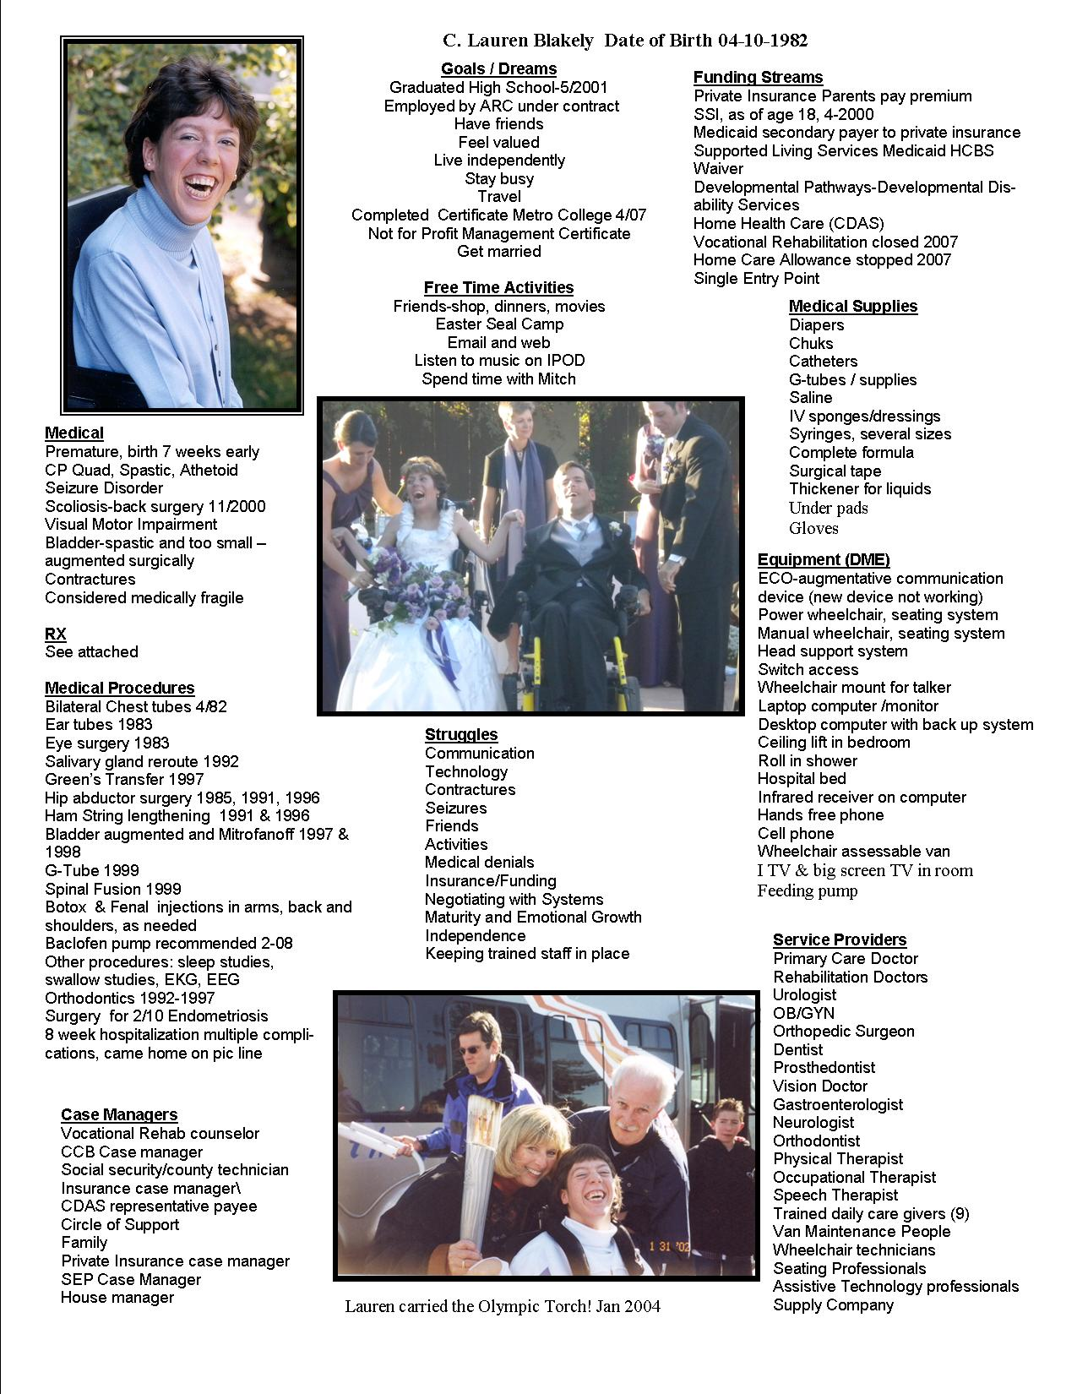

Slide 19
Adult HCBS Waivers
“Medical” Waivers
EBD-Elderly Blind and Disabled (Adult Home & Community Based Services) https://hcpf.colorado.gov/elderly-blind-disabled-waiver-ebd
Brain Injury https://hcpf.colorado.gov/brain-injury-waiver-bi
Mental Health
https://hcpf.colorado.gov/community-mental-health-supports-waiver-cmhs
“Developmental” Waivers
DD Developmental Disability, sometimes called Comprehensive or comp waiver
https://hcpf.colorado.gov/developmental-disabilities-waiver-dd
SLS Supported Living Services Waiver https://hcpf.colorado.gov/supported-living-services-waiver-sls
Coming June 1, 2023
www.familyvoicesco.org (303) 877-1747 info@familyvoicesco.org

Slide 20
Adult Medicaid Buy-In Program
Who Qualifies?
You must be between 16 or older,
You must be employed,
You must have a qualifying disability, either through Social Security or the State Disability Determination vendor, even if you are 65 or older. The Social Security Administration (SSA) listings describe what disabilities qualify, and
Your income after disregards must be below 450% of the Federal Poverty Level (FPL). For example, you can earn about $10,279 a month and qualify. You may have additional income that is disregarded.
Applicants should always complete the Health First Colorado Application to find out if their income qualifies.
You are not required to apply for SSA disability. If you do not have a current disability determination from the Social Security Administration, fill out the Health First Colorado Disability Application and on the How To Apply page. We will determine if you qualify using the Social Security Administration (SSA) listings, without regard to your substantial gainful activity or your ability to work.
www.familyvoicesco.org (303) 877-1747 info@familyvoicesco.org

Slide 21

Case Management Redesign
Community Centered Boards now called Case Management Agencies (CMA)
Happening in phases Nov 1, 2023 was first phase.
It is unclear who will do what after case management redesign takes place.
So while we say now go to Community Centered Board(CCB) if you need a Developmental Disability Waiver
Go to the Single Entry Point(SEP) for other waivers
Things are changing!
This Photo by Unknown Author is licensed under CC BY-NC

Slide 22
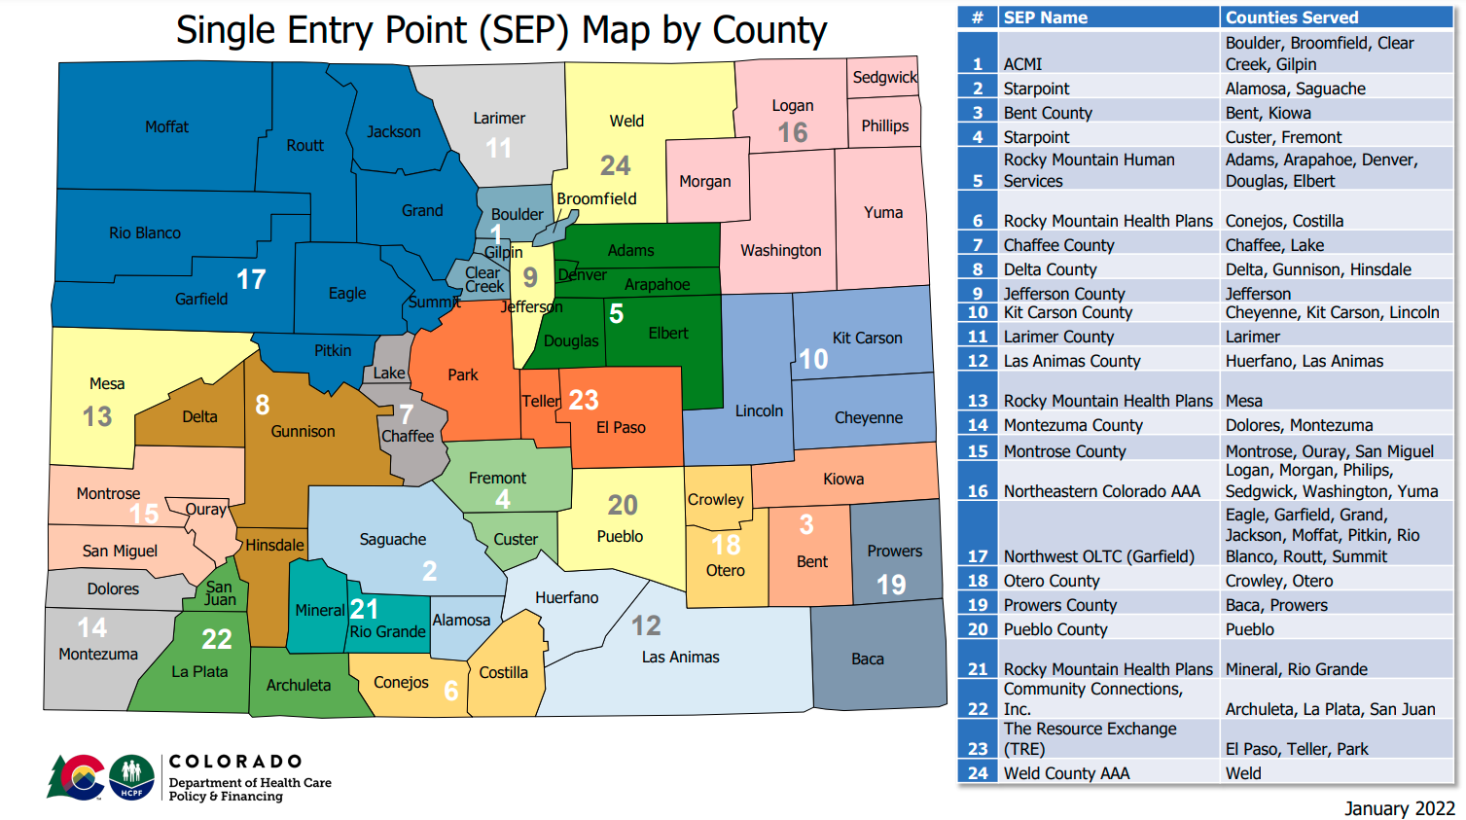
Where to apply?
Single Entry Point or Private Case Management Agencies
www.familyvoicesco.org (303) 877-1747 info@familyvoicesco.org

Slide 23
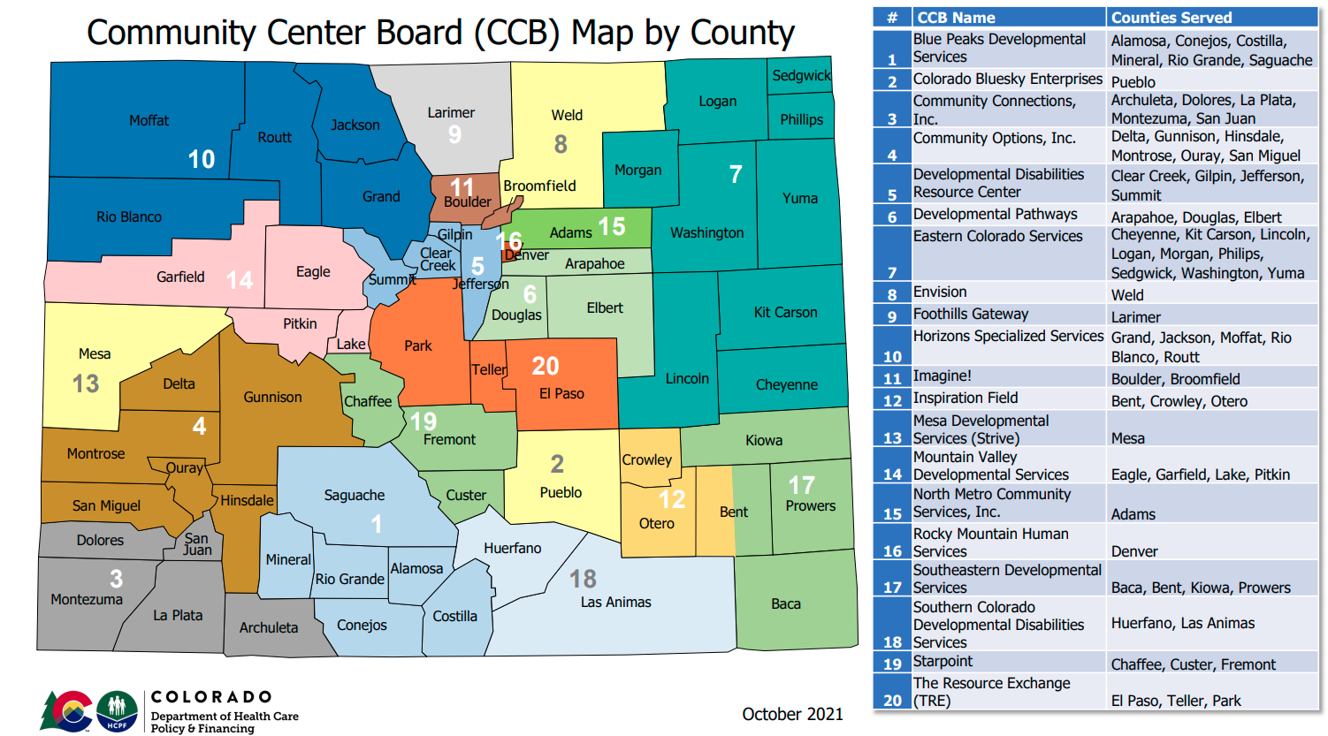
Where to apply?
Community Centered Board
www.familyvoicesco.org (303) 877-1747 info@familyvoicesco.org

Slide 24
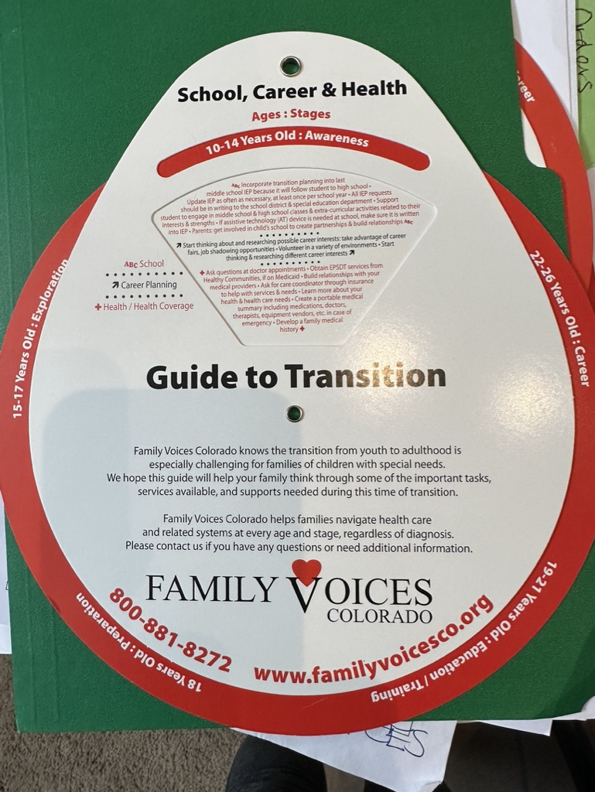
Transition Wheel
Covers ages 10-26
Covers :
  Health/ Health Coverage
  School
  Life Skills
  Family Involvement
  Career Planning
  Legal
  We will send you one!!
  Please put your address in the chat.

Slide 25
Hindsight Recommendations
Things to Think and talk about:
There is no one way to transition
Our fear factor is when we aren’t here….
Letting go is truly difficult!
Set up safe trials-leave at the mall, just hide in the bushes!
Create a vision for 5, 10, 15, 20 years
Be flexible
“The System” isn’t going to do it for you!
Think about the different areas of transition
We are here to help, you are not alone!
www.familyvoicesco.org (303) 877-1747 info@familyvoicesco.org

Slide 26
Resources and links
Disability According to Supplemental Security Income
https://www.ssa.gov/disability/professionals/bluebook/AdultListings.htm
Division of Vocational Rehabilitation
https://dvr.colorado.gov/youth-transition-services/youth
Health Care Policy and Financing- CO Medicaid or Health First CO
https://hcpf.colorado.gov
Community Centered Boards
https://hcpf.colorado.gov/community-centered-boards
PATH Scholarships
Lori Parker at pathwithlori@gmail.com
Ruth Newell at pathwithruth@gmail.com
PATHs 2 PossAbilities: www.paths2possabilities.net
PATH: “Planning Alternative Tomorrows with Hope”
1-844-584-3408
www.familyvoicesco.org (303) 877-1747 info@familyvoicesco.org

Slide 27
Questions?
Contact:
Main number (303) 877-1747
Megan Bowser - Family Navigator
megan@familyvoicesco.org
Gaby Diaz - Bilingual Family Navigator
gaby@familyvoicesco.org
Gina Stabile - Family Navigator
gina@familyvoicesco.org
Christy Blakely - Executive Director
christy@familyvoicesco.org
Chris McQuillen - Administrator
chris@familyvoicesco.org

