Slide 1

Who Does What?
www.familyvoicesco.org (303) 877-1747 info@familyvoicesco.org

Slide 2

Family Voices Overview
Family Led Nonprofit
Provide:
Systems Navigation
Education and Training
Advocacy and Policy
F2F Health Information Center
From MCHB & HRSA
Affiliate of Family Voices national organization
Christy S. Blakely
https://www.familyvoicesco.org/
(855) 877-1747
info@familyvoicesco.org

Slide 3
At Age 18 think about future…
5, 10, 15, 20 years
What can you see your transitioning youth doing?
  Living
    With parents?
    On their own?
    Group or host home?
  Working
    Part time?
    Full time?
    Supported employment?
  School
    Transition Program (UP TO 21)?
    Community College?
    Trade School
    Division of Vocational Rehab?
    Job training?
  Healthcare
    Health care understanding?
    Can they make their own appts?
    Can they refill medications?
  Recreation
    Activities
  Care Needs
    Does the youth receive home health care?
    Is parent the CNA?
    Can youth provide self care?
www.familyvoicesco.org (303) 877-1747 info@familyvoicesco.org

Slide 4
Adult HCBS Waivers
“Medical” Waivers
EBD-Elderly Blind and Disabled https://hcpf.colorado.gov/elderly-blind-disabled-waiver-ebd
Brain Injury https://hcpf.colorado.gov/brain-injury-waiver-bi
Mental Health https://hcpf.colorado.gov/community-mental-health-supports-waiver-cmhs
Complementary and Integrative Health Waiver (formerly spinal cord injury) https://hcpf.colorado.gov/complementary-integrative-health-waiver-cih
“Developmental” Waivers
DD Developmental Disability, sometimes called Comprehensive or comp waiver
https://hcpf.colorado.gov/developmental-disabilities-waiver-dd
SLS Supported Living Services Waiver https://hcpf.colorado.gov/supported-living-services-waiver-sls
www.familyvoicesco.org (303) 877-1747 info@familyvoicesco.org

Slide 5
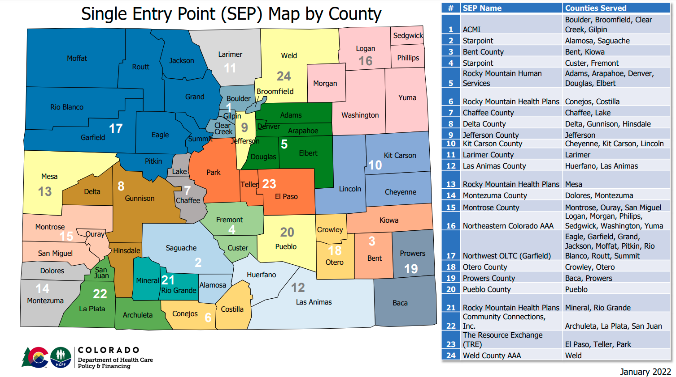
Adult “Medical” HCBS Waivers
“Medical” Waivers
EBD-Elderly Blind and Disabled (Adult Home & Community Based Services) https://hcpf.colorado.gov/elderly-blind-disabled-waiver-ebd
Brain Injury https://hcpf.colorado.gov/brain-injury-waiver-bi
Mental Health
https://hcpf.colorado.gov/community-mental-health-supports-waiver-cmhs
ALL Adult HCBS “Medical Waiver apply at
Apply at Single Entry Point (SEP)
www.familyvoicesco.org (303) 877-1747 info@familyvoicesco.org

Slide 6
Medical Waivers-EBD-Elderly Blind and Disabled (Adult Home & Community Based Services)
Who Qualifies?
You must meet the following financial and program criteria to access services under this program. To use waiver benefits, you must also be willing to receive services in your home or community.
Level of Care
You require long-term support services at a level comparable to services typically provided in a nursing facility.
Eligibility Group
You must be 18 years or older.
If you are between the ages of 18 and 64, you must be blind or have a physical disability, or have a diagnosis of HIV or AIDS.
If you are age 65 and older, you must have been determined to have a significant functional impairment.
Financial
Your income must be less than three times the current Federal Supplemental Security Income (SSI) limit per month. (See SSI website for current information)
For a single person, your countable resources must be less than $2,000.
For a couple, the countable resources must be less than $3,000.
If you do not meet these financial requirements, you may be eligible through the Health First Colorado Buy-In Program for Working Adults with Disabilities.
https://hcpf.colorado.gov/elderly-blind-disabled-waiver-ebd

Slide 7
Services-Elderly Blind & Disabled Waiver
If you are enrolled in the EBD waiver, you will receive regular Health First Colorado benefits. Additionally, you will also receive the following services specific to the EBD waiver:
Adult Day Services
Alternative Care Facilities
Consumer Directed Attendant Support Services (CDASS)
Home Delivered Meals
Home Modifications
Homemaker Services (with Remote Supports options)
In-Home Support Services (IHSS)
Life Skills Training
Medication Reminder
Non-Medical Transportation
Peer Mentorship
Personal Care (with Remote Supports options)
Personal Emergency Response System (PERS)
Respite Care
Transition Set Up

Slide 8
Medical Waivers- Brain Injury
Who Qualifies?
You must meet financial and program requirements to get BI waiver services. You must also be willing to get services in your home or community.
Level of Care Requirement
You must need long-term services as you would get in a nursing home or a hospital.
Eligibility Group
You must be 16 years or older.
You must have a brain injury.
Your brain injury occurred before your 65th birthday.
Your diagnosis must fit within certain categories. Contact your local Single Entry Point (SEP) to find out more.
Financial Requirements
Your income must be less than three times the current Federal Supplemental Security Income (SSI) limit per month. (See SSI website for current information)
If you are single, your countable resources must be less than $2,000. If you are married, your countable resources must be less than $3,000.
If you do not meet these financial requirements, you may be eligible through the Health First Colorado Buy-In Program for Working Adults with Disabilities.
https://hcpf.colorado.gov/brain-injury-waiver-bi

Slide 9
Services-Medical Waivers- Brain Injury
Benefits and Services
Adult Day Services
Assistive Devices
Behavioral Management and Education
Consumer Directed Attendant Support Services (CDASS)
Day Treatment
Home Delivered Meals
Home Modification
Independent Living Skills Training (ILST)
Medication Reminder
Mental Health Counseling
Non-Medical Transportation
Peer Mentorship
Personal Care (with Remote Supports options)
Personal Emergency Response System (PERS)
Respite Care
Specialized Medical Equipment and Supplies
Substance Abuse Counseling
Supported Living Program
Transition Set Up
Transitional Living Program

Slide 10
Medical Waiver-Mental Health
Who Qualifies?
You must meet the following financial and program criteria to access services under this program. To use waiver benefits, you must also be willing to receive services in your home or community.
Level of Care
You must require long-term support services at a level comparable to services typically provided in a nursing facility.
Eligibility Group
A person experiencing severe and persistent mental health needs that require assistance with one or more Activities of Daily Living (ADL),
  18 years of age or older with a severe and persistent mental health need,
  Currently has or at any time during the past year leading up to assessment has a diagnosable mental, behavioral, or emotional disorder of sufficient duration to meet diagnostic criteria specified within the Diagnostic and Statistical Manual of Mental Disorders (DSM-5), and
  Has a disorder that is episodic, recurrent, or has persistent features, but may vary in terms of severity and disabling effects, and
  Has resulted in functional impairment which substantially interferes with or limits one or more major activities.
A severe and persistent mental health need does not include:
  Intellectual or developmental disorders, or
  Substance use disorder without a co-occurring diagnosis of a severe and persistent mental health need.
Financial
Your income must be less than three times the current Federal Supplemental Security Income (SSI) limit per month. (See SSI website for current information)
For a single person, your countable resources must be less than $2,000.
For a couple, the countable resources must be less than $3,000.
If you do not meet these financial requirements, you may be eligible through the Health First Colorado Buy-In Program for Working Adults with Disabilities.
https://hcpf.colorado.gov/community-mental-health-supports-waiver-cmhs

Slide 11
Services-Medical Waiver-Mental Health
Benefits and Services
If you are enrolled in the CMHS waiver, you will receive regular Health First Colorado benefits. Additionally, you will also receive the following services specific to the CMHS waiver:
Adult Day Services
Alternative Care Facilities
Consumer Directed Attendant Support Services (CDASS)
Home Delivered Meals
Home Modifications
Homemaker Services (with Remote Supports options)
Life Skills Training
Medication Reminder
Non-Medical Transportation
Peer Mentorship
Personal Care (with Remote Supports options)
Personal Emergency Response System (PERS)
Respite Care
Transition Set Up
https://hcpf.colorado.gov/community-mental-health-supports-waiver-cmhs

Slide 12
Complementary and Integrative Health (CIH)
Who Qualifies?
The Home and Community-Based Services Complementary and Integrative Health waiver helps individuals living with a spinal cord injury, multiple sclerosis, a brain injury, spina bifida, muscular dystrophy, or cerebral palsy with the inability for independent ambulation.
To qualify for the CIH waiver, you must:
Be 18 years of age or older
Have a qualifying condition of a spinal cord injury (traumatic or nontraumatic), multiple sclerosis, brain injury, spina bifida, muscular dystrophy, or cerebral palsy
Have been determined to have an inability for independent ambulation resulting from the qualifying condition as identified by the case manager through the assessment process. The inability for independent ambulation for the HCBS-CIH waiver means:
  The individual does not walk, and requires use of a wheelchair or scooter in all settings, whether or not they can operate the wheelchair or scooter safely, on their own, OR;
  The individual does walk, but requires use of a walker or cane in all settings, whether or not they can use the walker or cane safely, on their own, OR;
  The individual does walk, but requires “touch” or “stand-by” assistance to ambulate safely in all settings.
Have been determined to be financially eligible
  If you do not meet the financial requirements, you may be eligible through the Health First Colorado Buy-In Program for Working Adults with Disabilities.
Have been determined to need long-term services and supports as you would receive in a nursing home or a hospital.
https://hcpf.colorado.gov/complementary-integrative-health-waiver-cih

Slide 13
Services-Complementary and Integrative Health (CIH)
Benefits and Services
Adult Day Services
Complementary and Integrative Health Services (Acupuncture, Chiropractic, Massage Therapy)
Consumer Directed Attendant Support Services (CDASS)
Home Delivered Meals
Home Modification
Homemaker Services (with Remote Supports options)
In-Home Support Services (IHSS)
Life Skills Training
Medication Reminder
Non-Medical Transportation
Peer Mentorship
Personal Care (with Remote Supports options)
Personal Emergency Response Systems (PERS)
Respite Care
Transition Set Up
https://hcpf.colorado.gov/complementary-integrative-health-waiver-cih

Slide 14
Developmental Disabilities Adult Waivers
“Developmental” Waivers
DD Developmental Disability, sometimes called Comprehensive or comp waiver
https://hcpf.colorado.gov/developmental-disabilities-waiver-dd
SLS Supported Living Services Waiver https://hcpf.colorado.gov/supported-living-services-waiver-sls
Coming June 1, 2023

Slide 15
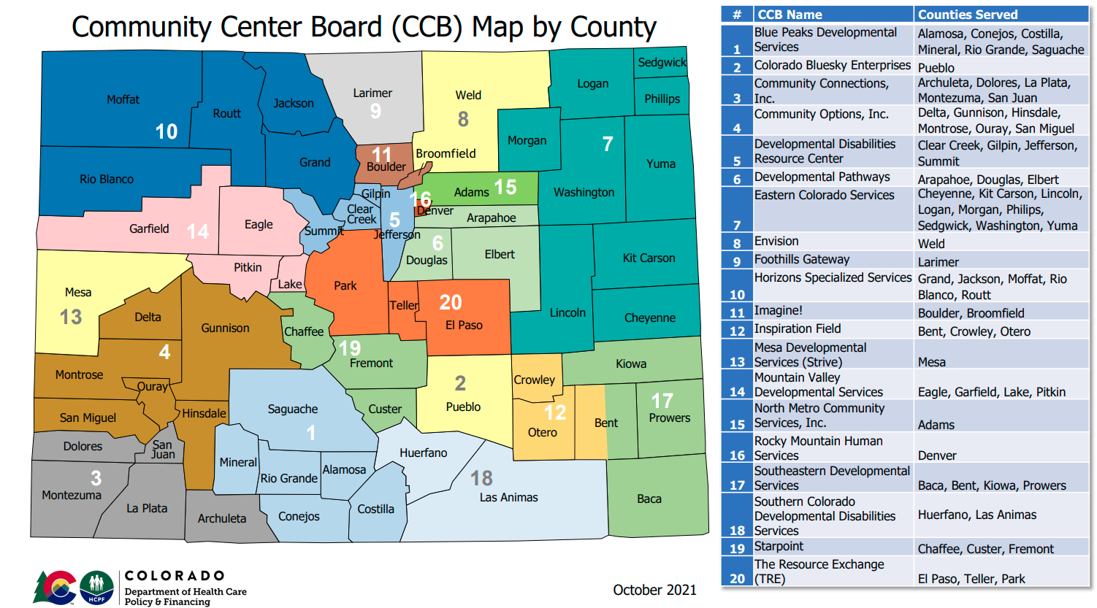
Adult “IDD” HCBS Waivers
“Medical” Waivers
EBD-Elderly Blind and Disabled (Adult Home & Community Based Services) https://hcpf.colorado.gov/elderly-blind-disabled-waiver-ebd
Brain Injury https://hcpf.colorado.gov/brain-injury-waiver-bi
Mental Health
https://hcpf.colorado.gov/community-mental-health-supports-waiver-cmhs
“Developmental” Waivers
DD Developmental Disability, sometimes called Comprehensive or comp waiver
https://hcpf.colorado.gov/developmental-disabilities-waiver-dd
SLS Supported Living Services Waiver https://hcpf.colorado.gov/supported-living-services-waiver-sls
Coming June 1, 2023
www.familyvoicesco.org (303) 877-1747 info@familyvoicesco.org

Slide 16
Developmental Disability Waiver-DD
Developmental Disabilities Waiver (DD)
Sometimes called the “comp or comprehensive waiver”
A waiver is an extra set of Health First Colorado (Colorado's Medicaid program) benefits that you could qualify for in certain cases. These benefits can help you remain in your home and community. Waivers have extra program rules and some programs may have waitlists.
The Home and Community-Based Services Waiver For Persons With Developmental Disabilities (DD) provides access to 24-hour, seven days a week supervision through Residential Habilitation and Day Habilitation Services and Supports. The service provider is responsible to support individuals in services to find living arrangements. Living arrangements can range from host homes settings with 1-2 persons, individualized settings of 1-3 persons, and group settings of 4-8 persons, as well as residential supports for participants who live in their own home or who live with and/or are provided services by members of their family.
Individuals who receive services through the DD waiver are also eligible for all Health First Colorado covered services as long as they are not duplicative.
https://hcpf.colorado.gov/developmental-disabilities-waiver-dd

Slide 17
Developmental Disability Waiver-DD
Who Qualifies?
To enroll in the DD waiver, you must meet financial and program criteria:
Level of Care
Intermediate Care Facility for Individuals with Intellectual Disabilities (ICF-IID) level of care as determined by the functional needs assessment(as defined in 42 CFR 440.150).
Eligibility Group
You must be determined to have a developmental disability.
You must be 18 years or older.
You must require access to services and supports 24 hours a day.
Financial
Your income must be less than three times the current Federal Supplemental Security Income (SSI) limit per month. (See SSI website for current information)
If you are single, your countable resources must be less than $2,000. If you are married, your countable resources must be less than $3,000.
If you do not meet these financial requirements, you may be eligible through the Health First Colorado Buy-In Program for Working Adults with Disabilities.
https://hcpf.colorado.gov/developmental-disabilities-waiver-dd

Slide 18
Developmental Disability Waiver-DD
Benefits and Services
If you are enrolled in the DD waiver, you may receive the following services to address needs:
Behavioral Services
Day Habilitation Services (Specialized Habilitation, Supported Community Connections)
HCBS Dental Services
Home Delivered Meals
Non-Medical Transportation
Peer Mentorship
Prevocational Services
Residential Habilitation Services (24-hour individual or group)
Specialized Medical Equipment and Supplies
Supported Employment
Transition Set Up
Vision Services
https://hcpf.colorado.gov/developmental-disabilities-waiver-dd

Slide 19
Supported Living Services
Who Qualifies?
To enroll in the HCBS-SLS waiver the individual must meet financial and program criteria:
Level of Care
  Individuals must meet Intermediate Care Facility for Individuals with Intellectual Disabilities (ICF-IID) level of care as determined by the functional needs assessment (as defined in 42 CFR § 440.150)
Eligibility Group
  Individuals must be determined by a Community Centered Board (CCB) to have a developmental disability
  Individuals must be 18 years or older
Financial
  Your income must be less than three times the current Federal Supplemental Security Income (SSI) limit per month. (See SSI website for current information)
  For a single person, their countable resources must be less than $2,000 and for a couple it must be less than $3,000.
  If you do not meet these financial requirements, you may be eligible through the Health First Colorado Buy-In Program for Working Adults with Disabilities.
https://hcpf.colorado.gov/supported-living-services-waiver-sls

Slide 20
Services-Supported Living Services
SLS Waiver Services
Assistive Technology
Behavioral Services
Consumer Directed Attendant Support Services (CDASS)
Day Habilitation Services (Specialized Habilitation, Supported Community Connections)
HCBS Dental Services
Health Maintenance Activities
Home Delivered Meals
Home Modifications
Homemaker Services (with Remote Supports options)
Life Skills Training
Mentorship
Non-Medical Transportation
Peer Mentorship
Personal Care Services (with Remote Supports options)
Personal Emergency Response System (PERS)
Prevocational Services
Professional Services (Includes Hippotherapy, Massage & Movement Therapy)
Respite Services
Specialized Medical Equipment and Supplies
Supported Employment
Transition Set Up
Vehicle Modifications
Vision Services
https://hcpf.colorado.gov/supported-living-services-waiver-sls

Slide 21
Buy in Program for Working Adults
Who qualifies?
You must be between 16 or older,
You must be employed,
You must have a qualifying disability, either through Social Security or the State Disability Determination vendor, even if you are 65 or older. The Social Security Administration (SSA) listingsdescribe what disabilities qualify, and
Your income after disregards must be below 450% of the Federal Poverty Level (FPL). For example, you can earn about $11,020 a month and qualify. You may have additional income that is disregarded.
Applicants should always complete the Health First Colorado Application to find out if their income qualifies.
You are not required to apply for SSA disability. If you do not have a current disability determination from the Social Security Administration, fill out the Health First Colorado Disability Application and on the How To Apply page. We will determine if you qualify using the Social Security Administration (SSA) listings, without regard to your substantial gainful activity or your ability to work.
https://hcpf.colorado.gov/buy-in-program-working-adults-disabilities

Slide 22
Medical & IDD - Transition
Medical Transition includes:
      1. Decision making about insurance
      Do I keep my child on my private insurance after age 18? Legally, you can, until 26!
      Depending on the insurance carrier, you can petition every year for a disabled adult to stay on your private insurance-
      WHY keep them on private insurance? Access to doctors, access to care, better payments for providers, better overall coverage
      2. Decision making about Transitioning to Adult Health Care
      Ask each provider their age/stage when they transition to adult care
      Create a plan for transitioning and get the records to share
      Create a care notebook to communicate to new providers both medical history and goals
      3. Decision making about how to access Home Health Care (if appropriate)
      Discuss the options with case manager or someone who understands consumer Directed Attendant Support Services, versus agency, based home health care.
      https://hcpf.colorado.gov/consumer-directed-attendant-support-services
      4. Early, Periodic, Screening Diagnostics and Treatment (EPSDT) under Medicaid is from 0- 21st birthday. https://hcpf.colorado.gov/early-and-periodic-screening-diagnostic-and-treatment-epsdt
www.familyvoicesco.org (303) 877-1747 info@familyvoicesco.org
‹#›

Slide 23
Medical & IDD - Transition
IDD Transition includes:
      HCBS Adult Waiver chart -
      https://hcpf.colorado.gov/sites/hcpf/files/HCBS%20Adult%20Waiver%20and%20PACE%20Comparison%20Chart-April-2023.pdf
      At 18 in the IDD waivers there is an evaluation called the Supports Intensity Scale (SIS)
      This eval equals level of care and that equates to the funding your young adult will receive, they get levels 1-6,
      The SIS evaluation is done once and re-evaluated if there are significant changes.
      Once on an IDD waiver (DD or SLS) a Service Plan (soon to be called a Person Centered Support Plan) will be written, related to goals and needs, this is written annually, along with the ULTC 100.2 assessment
      NOTE: In order to qualify for Developmental Disability services the young adult must have an IQ under 70 OR an Adaptive Behavior Score that is low.
www.familyvoicesco.org (303) 877-1747 info@familyvoicesco.org
‹#›

Slide 24
Supports Intensity Scale -SIS
This scale should be completed without regard to the services or supports currently provided or available. Scores should reflect the supports that would be necessary for this person to be successful. If an individual uses assistive technology, the person should be rated with said technology in place. Complete ALL items, even if the person is not currently performing a listed activity.
TYPE OF SUPPORT | FREQUENCY | DAILY SUPPORT TIME
What kind of support should be provided? 0 = none 1 = monitoring 2 = verbal/gestural prompting 3 = partial physical assistance 4 = full physical assistance | How frequently is support needed for this activity? 0 = none or less than monthly 1 = at least once a month, but not once a week 2 = at least once a week, but not once a day 3 = at least once a day, but not once an hour 4 = hourly or more frequently | On a typical day when support in this area is needed, how much time should be devoted? 0 = none 1 = less than 30 minutes 2 = 30 minutes to less than 2 hours 3 = 2 hours to less than 4 hours 4 = 4 hours or more

Slide 25
Supports Intensity Scale -SIS
RATING KEY
0 = No Support Needed
1 = Some Support Needed [i.e., providing monitoring and/or occasional assistance]
2 = Extensive Support Needed [i.e., providing regular assistance to manage the medical condition or behavior]
Section 1A: Exceptional Medical Support Needs (19 Items)
▪ Respiratory Care (4 Items)
▪ Feeding Assistance (3 Items)
▪ Skin Care (2 Items)
▪ Other Exceptional Medical Care (10 Items)
Section 1B: Exceptional Behavioral Support Needs (13 Items)
Exceptional Medical Support Needs (19 Items)
▪ Externally Directed Behavior (4 Items) ▪ Self-Directed Behavior (3 Items)
▪ Sexual Behavior (2 Items)
▪ Other (4 Items)
The SIS places the individual into level 1-6
Level 7 requires an appeal process based on need

Slide 26
Supports Intensity Scale -SIS
Section 2 Supports Needs Index
Section 2A: Home Living Activities (8 Items)
Section 2B: Community Living Activities (8 Items)
Section 2C: Lifelong Learning Activities (9 Items)
Section 2D: Employment Activities (8 Items)
Section 2E: Health and Safety Activities (8 Items)
Section 2F: Social Activities (8 Items)
Section 3 Supplemental Protection and Advocacy Scale
Protection and Advocacy Activities (8 Items)
The SIS places the individual into level 1-6
Level 7 requires an appeal process based on need

Slide 27

Electronic Medical Records
Access to your child's electronic health record (My Chart) varies by age:
Under 14: Parents have full access to the child's MyChart account.
Ages 14-18: In order to provide confidentiality for our patients, parents have limited access. Parents can continue to message the care team and see test results. Teen patients can request their own MyChart account with full access to their health record.
18 or older: Parents cannot create a MyChart account. The patient may have their own MyChart account.
Special needs: If a child has diminished capacity and is unable to make healthcare decisions, an exception can be made that allows parents to retain full access to their child's MyChart account. Please discuss this with your child's healthcare team.
Check with your young adult’s providers!
This Photo by Unknown Author is licensed under CC BY-SA

Slide 28
Adult Paid Family Caregiver Options
CNA or PDN
Is available under the EBD or SLS
Must qualify for Long-term Care
Must qualify for skilled care, hours are determined by PAT tool until 21 or in home assessment by a nurse
Family member must obtain their CNA or nursing license
Employed by a home health agency with same requirements as if a non-family member provided services
CDASS
Is available under EBD or SLS
Must be on the EBD or SLS Waiver
Must qualify for skilled care - health maintenance activities (HMA)
CHCBS case manager completes assessment to determine hours
Nurse Practice Act is waived so no licensure is required
Employed by a home health agency
May be provided by family members or outside providers
www.familyvoicesco.org (303) 877-1747

Slide 29
Adult Paid Family Caregiver Options
DD waiver pays a daily rate, based on Supports Intensity Score (SIS) score
There is NO home health benefit under the DD Waiver
PDN changes for adults
No services shall be authorized or reimbursed if hours of service, regardless of funding source, total more than 24 hours per day for members age 20 or younger and no more than 23 hours per day for members age 21 or older.
www.familyvoicesco.org (303) 877-1747

Slide 30
Financial- Transition
Financial Transition includes:
      1. Decision making about Supplemental Security Income (SSI)
      Does my young adult qualify for SSI?
      Will my young adult be working?
      Does my young adult have a disability determination?
      Is my child moving out of my home? (If not, they will need to pay rent is receiving SSI)
      Which Home and Community Based Service (HCBS) Waiver is best for my child? (June 1, 2023)
      2. Decision making about creating Special Needs Trust
      Discuss with someone knowledgeable about Special Needs Trusts and why they are important. (July 6, 2023)
      Parents at this age worry for when they are not around, plan!
      Ensuring the adult child has a bank account with a parent/caregiver/guardian’s name on it
          SSI limits individuals to no more than $2000 available, options include ABLE accounts (July 6,2023)
www.familyvoicesco.org (303) 877-1747 info@familyvoicesco.org
‹#›

Slide 31
Who is Eligible for Supplemental Security Income (SSI)?
Adults Who:
Are age 65 and older, or blind, or have a disability.
Have limited income (wages, pensions, etc.).
Have limited resources (the things you own).
Are U.S. citizens, nationals of the U.S., and some noncitizens.
Reside in one of the 50 states, the District of Columbia, or the Northern Mariana Islands. It does not include Puerto Rico, Guam, or the United States Virgin Islands. Exception: The children of military parent(s) assigned to permanent duty outside the U.S. and certain students temporarily abroad may receive SSI payments outside the U.S.
https://www.ssa.gov/ssi/
Children Who:
Are under age 18 and have physical or mental condition(s) that very seriously limits their daily activities for a period of 12 months or more or may be expected to result in death, and
Live in a household with limited income (benefits based on need) or resources.
https://www.ssa.gov/benefits/disability/apply-child.html

Slide 32
School & Employment- Transition
School & Employment Transition includes:
      1. Decision making about school services
      Do I keep my child in the school Transition program after age 18?
      Typically, they graduate with their class at 18, then have 3 years(until 21 in a transition program)
      Transition Programs can be anything from learning life skills to job training to higher education, it is an individualized program
      Is continued or higher education a possibility?
      If higher education, there must be a work-related goal.
      Higher education is becoming more available, for individuals with IDD!
      2. Decision making about Employment
      Discuss as a family what your young adult likes or can do, investigate or shadow, if possible
      Discuss as a family obtainable goals
      Ask about Division of Vocational Rehabilitation(DVR)
      Ask about the SWAP Program https://dvr.colorado.gov/youth-transition-services/youth
www.familyvoicesco.org (303) 877-1747 info@familyvoicesco.org
‹#›

Slide 33
Legal-Transition
Legal Transition includes:
      1. Decision making about Power of Attorney and/or Guardianship
      Understand the differences in Medical Power of Attorney, Power of Attorney and Guardianship (webinar July 6, 2023)
      2. Guardianship Alliance, Guardianship classes
      https://www.abilityconnectioncolorado.org/guardianshipallianceofcolorado/guardian-training-classes
      Upcoming classes: The cost of the Guardianship Training Class is $150.00
June 10, 2023
August 12, 2023
October 14, 2023
November 9, 2023
www.familyvoicesco.org (303) 877-1747 info@familyvoicesco.org
‹#›

Slide 34
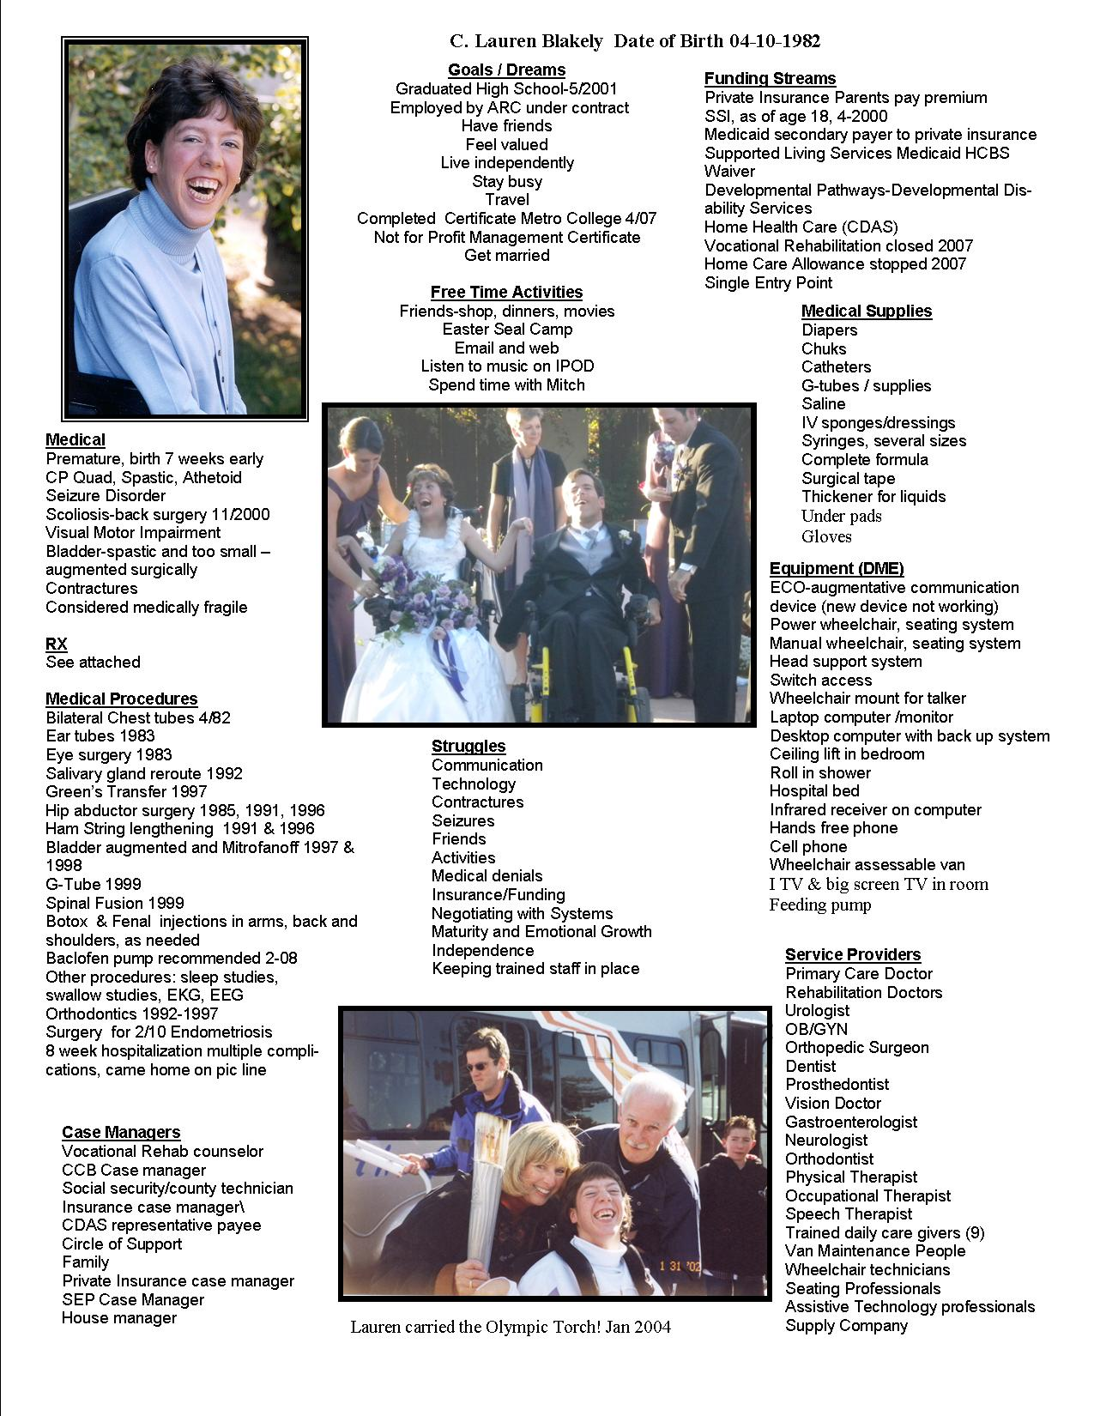

Slide 35

Case Management Redesign
It is unclear who will do what after case management redesign takes place.
So while we say now go to Community Centered Board(CCB) if you need a Developmental Disability Waiver
Go to the Single Entry Point(SEP) for other waivers
Things are changing!
This Photo by Unknown Author is licensed under CC BY-NC

Slide 36
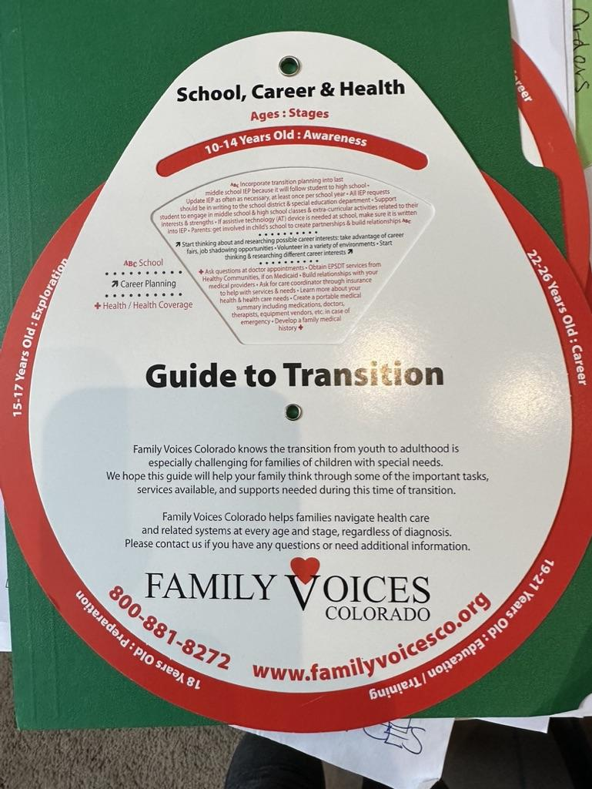
Transition Wheel
Coming Soon!
Covers ages 10-26
Covers :
  Health/ Health Coverage
  School
  Life Skills
  Family Involvement
  Career Planning
  Legal
  We will send you one!!

Slide 37
Hindsight Recommendations
Things to Think and talk about:
They adult HCBS Waiver System is confusing
There is no one way to transition
Our fear factor is when we aren’t here….
Letting go is truly difficult!
Ask open ended questions, “What would you do?”
Set up safe trials-leave at the mall, just hide in the bushes!
Create a vision for 5, 10, 15, 20 years
Be flexible
“The System” isn’t going to do it for you!
Think about the different areas of transition
We are here to help, you are not alone!
www.familyvoicesco.org (303) 877-1747 info@familyvoicesco.org

Slide 38
Resources and links
Disability According to Supplemental Security Income
https://www.ssa.gov/disability/professionals/bluebook/AdultListings.htm
Division of Vocational Rehabilitation
https://dvr.colorado.gov/youth-transition-services/youth
Health Care Policy and Financing- CO Medicaid or Health First CO
https://hcpf.colorado.gov
Community Centered Boards
https://hcpf.colorado.gov/community-centered-boards
PATH Scholarships
Lori Parker at pathwithlori@gmail.com
Ruth Newell at pathwithruth@gmail.com
PATHs 2 PossAbilities: www.paths2possabilities.net
PATH: “Planning Alternative Tomorrows with Hope”
1-844-584-3408
www.familyvoicesco.org (303) 877-1747 info@familyvoicesco.org

Slide 39
Questions?
Contact:
Main number (303) 877-1747
Megan Bowser - Family Navigator
megan@familyvoicesco.org
Gaby Diaz - Bilingual Family Navigator
gaby@familyvoicesco.org
Gina Stabile - Family Navigator
gina@familyvoicesco.org
Christy Blakely - Executive Director
christy@familyvoicesco.org
Chris McQuillen - Administrator
chris@familyvoicesco.org

