Slide 1
Building Your
Advocacy Skills
www.familyvoicesco.org (303) 877-1747 info@familyvoicesco.org

Slide 2
Caregiver Conversations
Webinars on the first Thursday of every month.
7:00 PM-8:30 PM
We know your time is precious we and are committed to providing information in a specific timeline.
Our timeline:
7:00-7:10 Intros and Overview
7:10-8:00 Information
8:00-8:30 Questions/Answers
NOTE: Please do not share private health information, as we are recording this webinar. If you have questions that are of a more private nature, one of our staff will connect with you, at another time.

Slide 3
Family Voices Overview
Family Led Nonprofit
Provide:
Systems Navigation
Education and Training
Advocacy and Policy
F2F Health Information Center
Affiliate of Family Voices national organization
https://www.familyvoicesco.org/
(855) 877-1747
info@familyvoicesco.org

Slide 4
Advocacy:
any action that speaks in favor of, recommends, argues for a cause, supports or defends, or pleads on behalf of others.
It’s YOUR table!

Slide 5
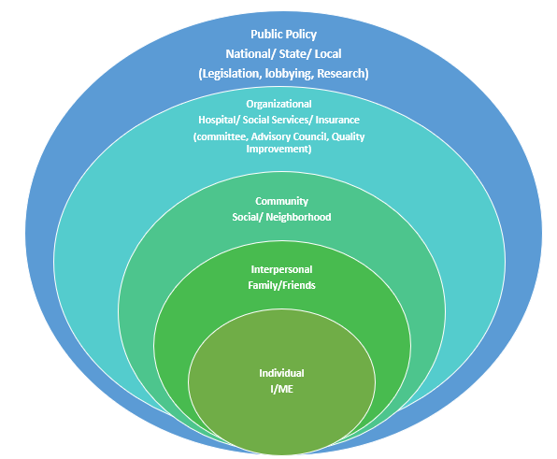
Circles of Engagement
1. Individual (I/Me, Immediate Family)
2. Interpersonal (Extended Family/Friends)
3. Community (Social/Neighborhood)
4. Organizational - Hospital/Social Services/Insurance (Committee, Advisory Council, Quality Improvement)
5. Public Policy - National/State/Local (Legislation, Lobbying, Research)
5
4
3
2
1

Slide 6
Individual (I/Me, My Family)
Focus on you,
your child/youth,
and your family
1

Slide 7
2. Interpersonal (Family/Friends)
Expand focus to friends and extended family
2

Slide 8
3. Community (Social/Neighborhood)
(Medical Team, School Team, Recreation Programs, Neighborhood, Religious Communities)
Educating and improving communities to widen support and build futures
3

Slide 9
4. Systems - Hospital / Social Services / Insurance / Mental Health
Committees, Local Policy, Systems Change
to better access for all
4

Slide 10
5. Public Policy - National / State / Local (Legislation, Lobbying, Research)
Lasting impact at state and federal levels
5
Notes:
LISA - 15 seconds
TEASER
not talking about today … but role in public policy environments to help advocate for positive changes in the child welfare system
experience at individual to make systems level changes
build comfort/confidence
interest in future lunch n’ learn?

Slide 11
Keep Your Foundation Strong
1

Slide 12
Danae Davison
PEAK Parent Center
-Parent Advisor

Slide 13
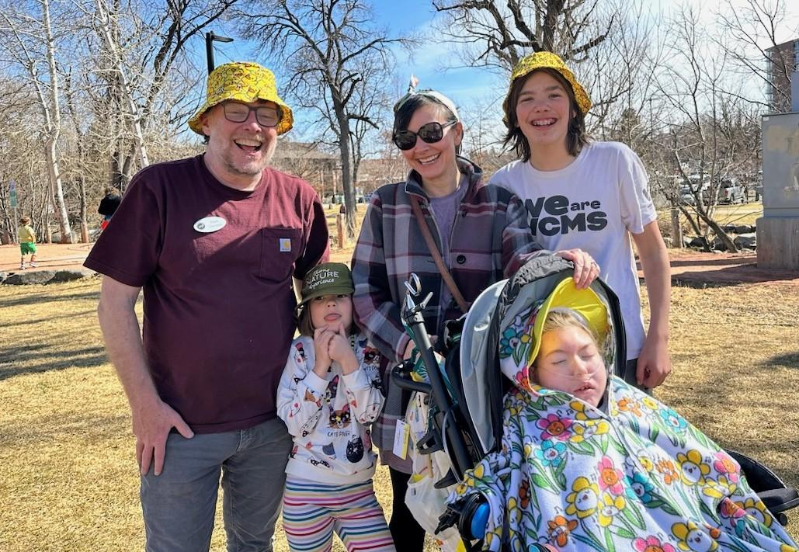

Slide 14
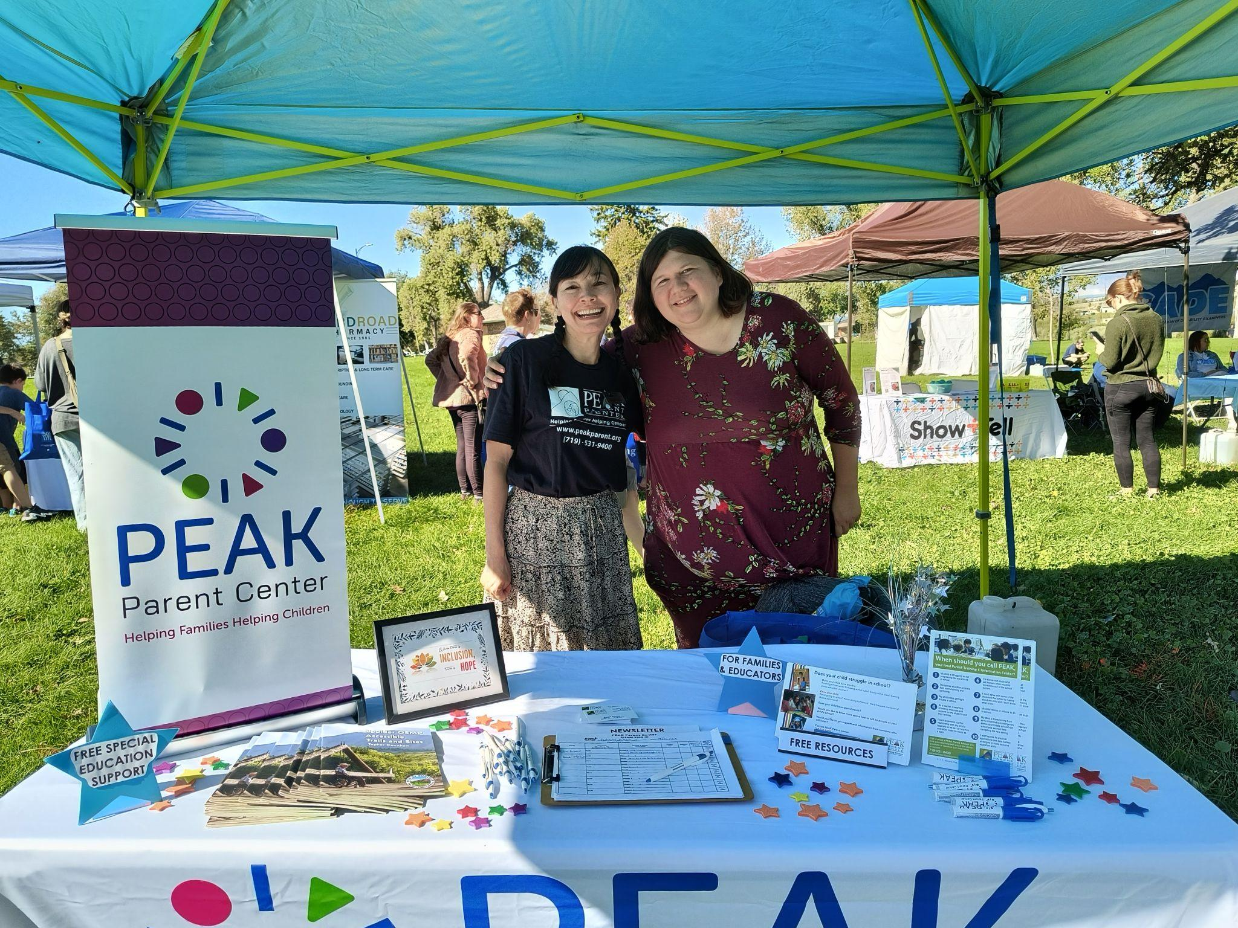

Slide 15
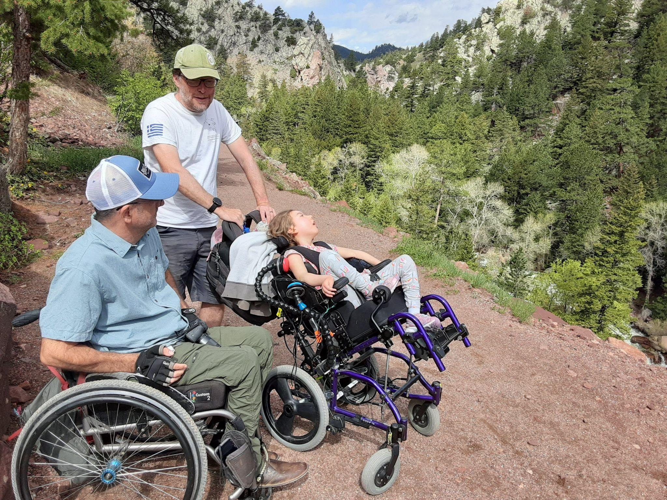

Slide 16
Nikki Martin
Parent to Parent of Colorado
-Project Coordinator, Family Engagement

Slide 17
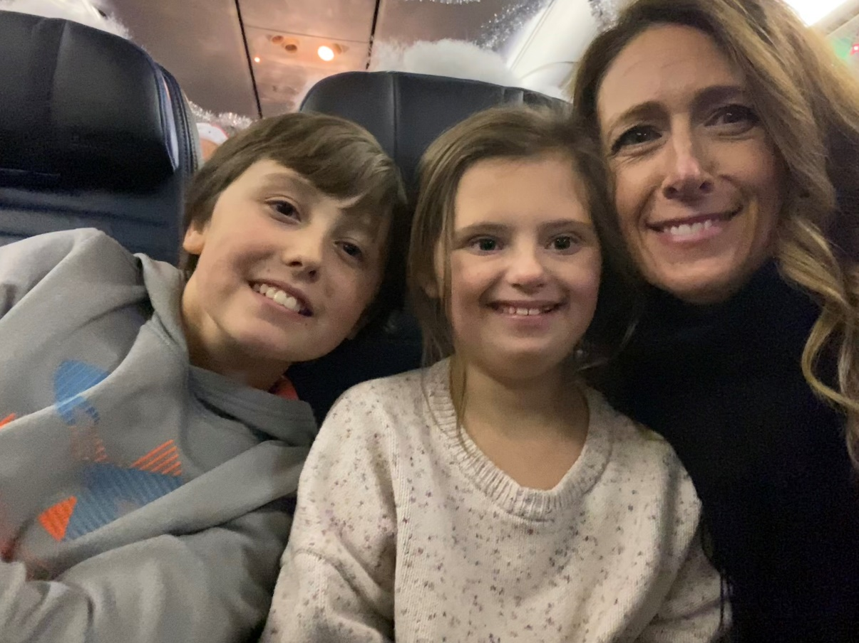
My family…

Slide 18
Parent to Parent of Colorado (P2P-CO)
One-to-one parent matching
Online message boards (24/7)
Parent
Policy
EMPOWER (youth mental health/wellness) Padre a Padre de Colorado
Zoom support groups
2nd Friday, 10-11:30am
4th Thursday, 6:30-8pm
p2p-co.org
@P2PCO

Slide 19
Start small… …just start somewhere.

Slide 20
Denice Chinchilla
El Grupo Vida
-

Slide 21
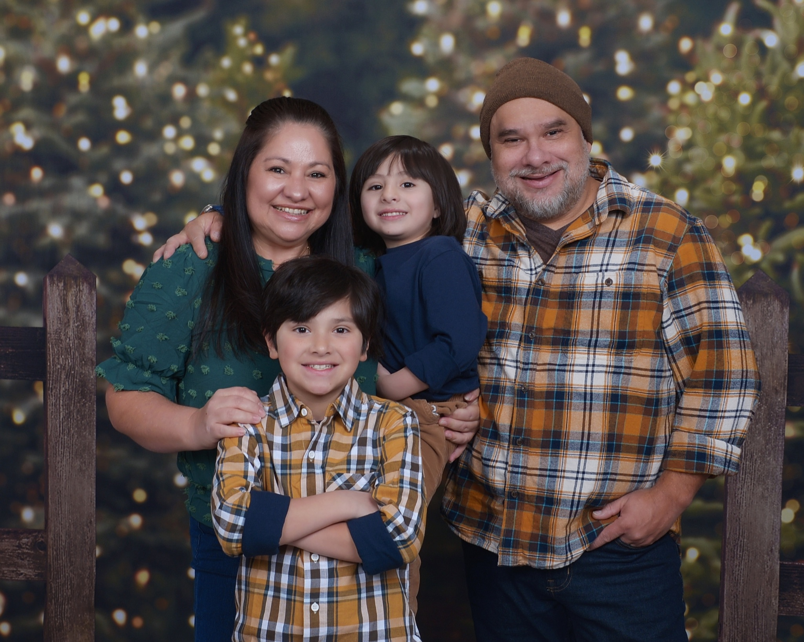
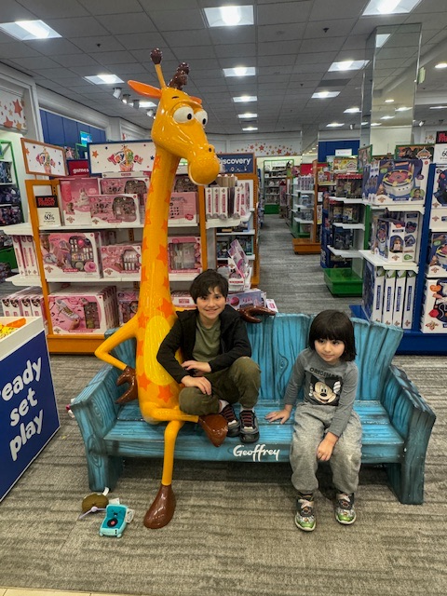
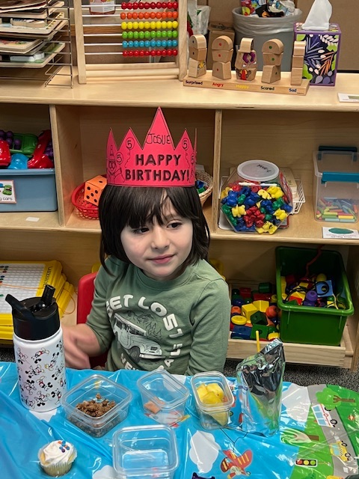

Slide 22
EL GRUPO VIDA’S MISSION |
LA MISIÓN DE EL GRUPO VIDA
The mission of El Grupo Vida is to empower immigrants with disabilities and their families with information, training, and direct advocacy to help them become more self-sufficient and give our community a voice, raising awareness about our rights.
La misión de El Grupo Vida es fortalecer a las personas inmigrantes que tienen alguna discapacidad y a sus familias con información, capacitación y defensoría directa para ayudarles a ser más autosuficiente y darle voz a nuestra comunidad, dando conocimiento sobre nuestros derechos.

Slide 23
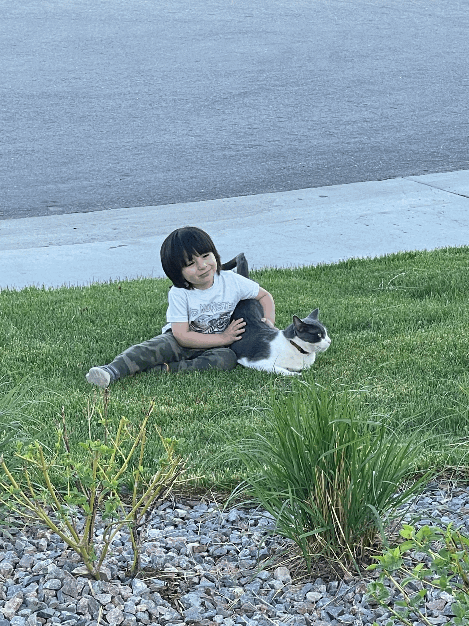
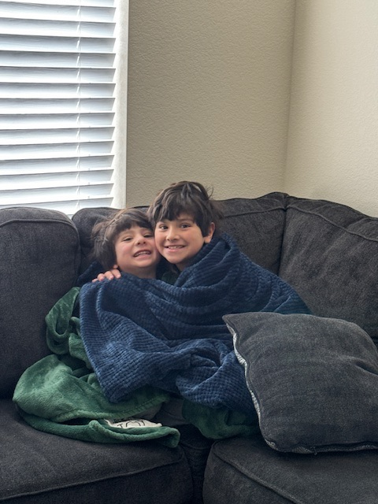
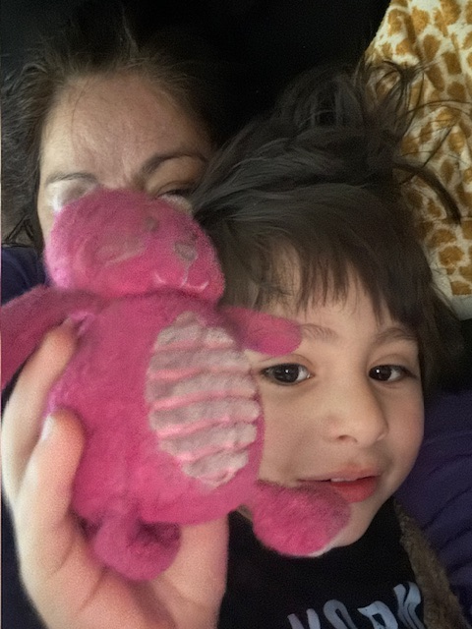

Slide 24
